Slide 1

Navigation

Slide 2
Agenda
Navigation tags
Hyperlink
Reference to intermediate section

Slide 3

Navigation tags

Slide 4
The <nav> tag is one of the HTML5 elements.
It is used to specify a block of navigation links, either within the current document or to other documents.
Examples of navigation blocks are tables of contents, menus, and indexes.
Syntax:The <nav> tag comes in pairs. The content is written between the opening (<nav>) and closing (</nav>) tags.

Slide 5
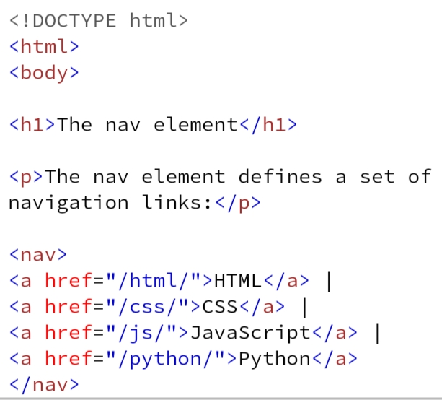
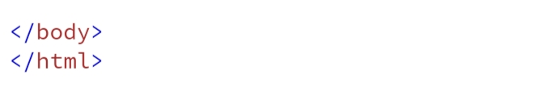

Slide 6
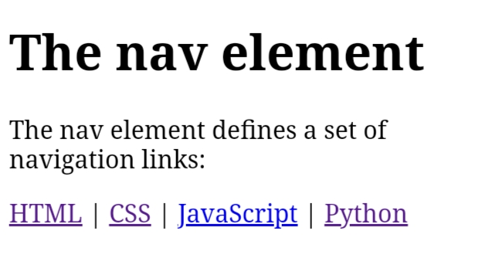

Slide 7
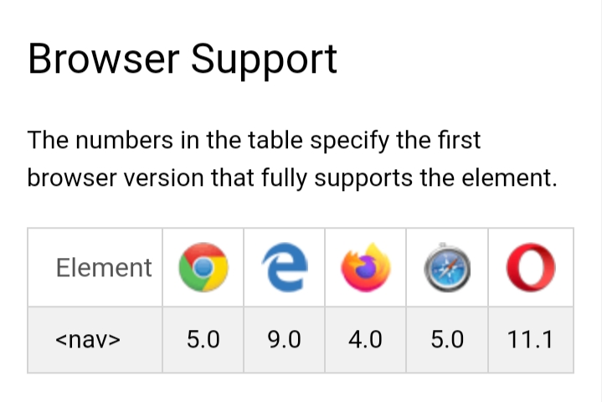

Slide 8

Hyperlink

Slide 9

HTML Links - Hyperlinks
Links are found in nearly all web pages. Links allow users to click their way from page to page.
When you move the mouse over a link, the mouse arrow will turn into a little hand.
A link does not have to be text. A link can be an image or any other HTML element.
HTML Links - Syntax:The HTML <a> tag defines a hyperlink.

Slide 10
By default, links will appear as follows in all browsers:
An unvisited link is underlined and blue
A visited link is underlined and purple
An active link is underlined and red
<a href="https://www.google.com/">Visit Google.com!</a>

Slide 11
HTML Links - The target Attribute
By default, the linked page will be displayed in the current browser window.
To change this, you must specify another target for the link.
The target attribute specifies where to open the linked document.
The target attribute can have one of the following values:
_self - Default. Opens the document in the same window/tab as it was clicked
_blank - Opens the document in a new window or tab
_parent - Opens the document in the parent frame
_top - Opens the document in the full body of the window

Slide 12
Absolute URLs vs. Relative URLs
Absolute URLs vs. Relative URLs
Both examples above are using an absolute URL (a full web address) in the href attribute.
A local link (a link to a page within the same website) is specified with a relative URL (without the "https://www" part):

Slide 13
<!DOCTYPE html>
<html>
<body>
<h2>Absolute URLs</h2>
<p><a href="https://www.cts.org/">W3C</a></p>
<p><a href="https://www.google.com/">Google</a></p>
<h2>Relative URLs</h2>
<p><a href="html_images.asp">HTML Images</a></p>
<p><a href="/css/default.asp">CSS Tutorial</a></p>
</body>
</html>

Slide 14
Link to an Email Address
Use mailto: inside the href attribute to create a link that opens the user's email program (to let them send a new email):
Example
<a href="mailto:someone@example.com">Send email</a>

Slide 15
Button as a Link
To use an HTML button as a link, you have to add some JavaScript code.
JavaScript allows you to specify what happens at certain events, such as a click of a button:
Example
<button onclick="document.location='default.asp'">HTML Tutorial</button>

Slide 16

HTML5 section tag

Slide 17
HTML <section> Tag
The <section> tag defines a section in a document.

Slide 18
<!DOCTYPE html>
<html>
<body>
<h1>The section element</h1>
<section>
<h2>WWF History</h2>
<p>The World Wide Fund for Nature (WWF) is an international organization working on issues regarding the conservation, research and restoration of the environment, formerly named the World Wildlife Fund. WWF was founded in 1961.</p>
</section>
<section>
<h2>WWF's Symbol</h2>
<p>The Panda has become the symbol of WWF. The well-known panda logo of WWF originated from a panda named Chi Chi that was transferred from the Beijing Zoo to the London Zoo in the same year of the establishment of WWF.</p>
</section>
</body>
</html>

Slide 19
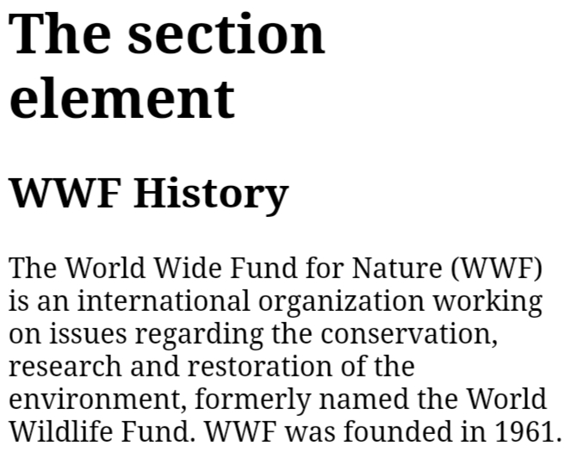
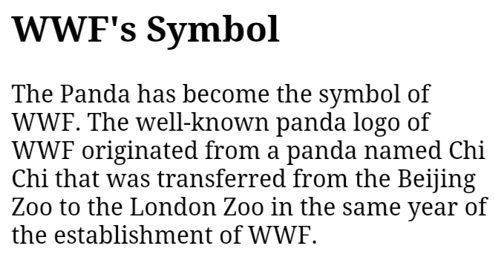

Slide 20


